Slide 1

Li-Fi Communication System
A wireless communication technology that uses light to transmit data between devices. This presentation explores the transmitter and receiver circuit theory behind Li-Fi systems.

Slide 2
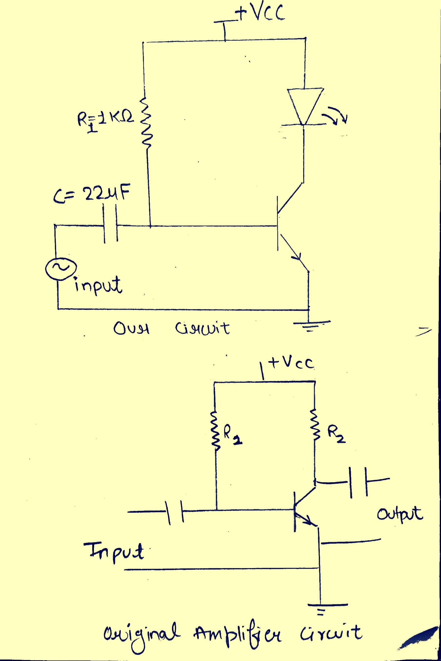



Transmitter Circuit Theory
Core Principle
Key Components
Modulate an LED's light intensity using an input audio signal to transmit data via Li-Fi.
Transistor amplifier, LED (3.3V forward voltage), resistor R1 for biasing, and capacitor for DC blocking.
Signal Processing
Small AC audio signals modulate the transistor's base-emitter voltage, causing LED brightness to fluctuate at the signal frequency.

Slide 3
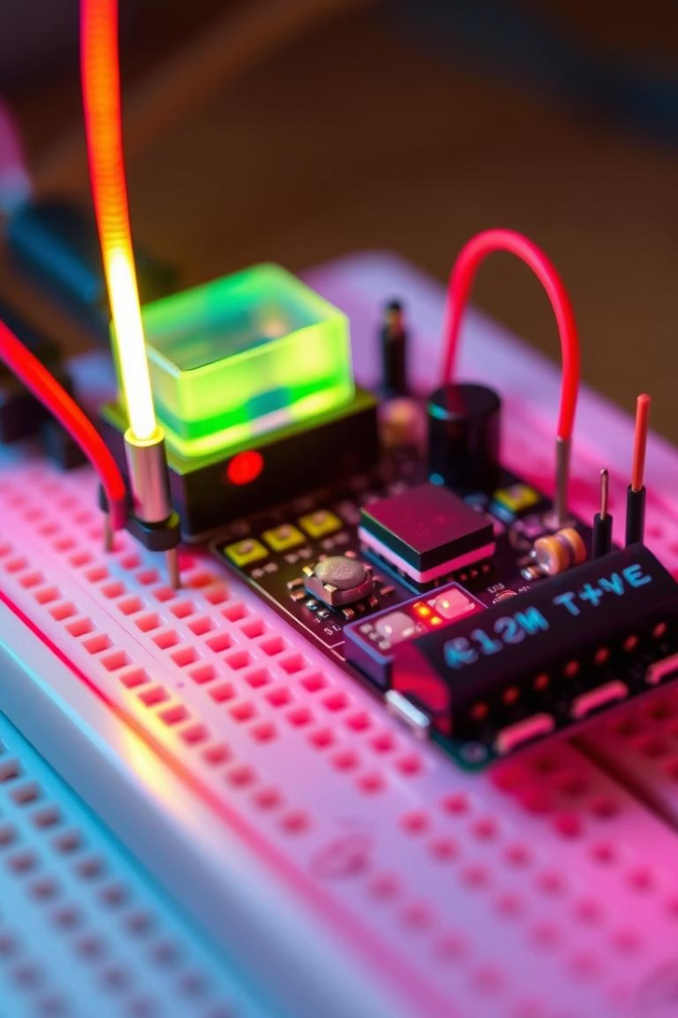



Transmitter Circuit Operation
Input Signal
Small AC audio signal applied to transistor's base via coupling capacitor that blocks DC.
Transistor Amplification
Base terminal is fed some voltage via resistance R1 that ensures the LED is always forward biased.
LED Drive
Transistor acts as current sink. Increasing VBE brightens LED; decreasing VBE dims LED.

Slide 4
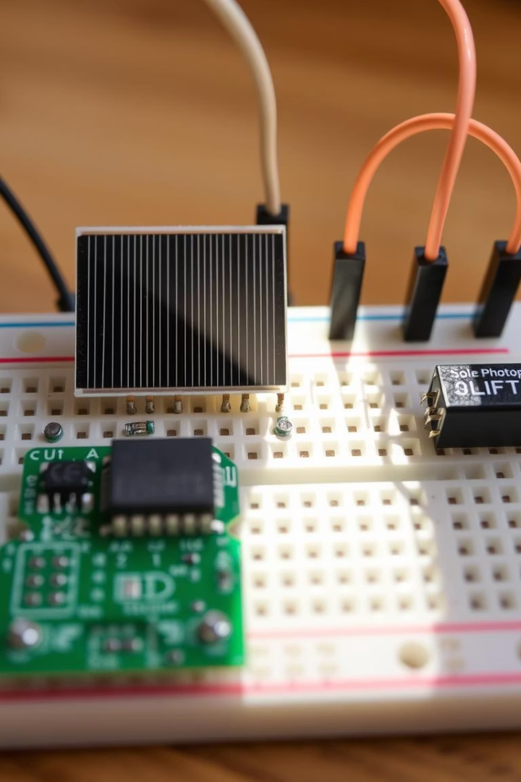
Receiver Circuit Theory
Core Principle
Key Components
Detect light signals from the LED transmitter and convert them back into electrical audio signals.
Photodetector (solar panel), Capacitor-Resistor Network, and OP-AMP.
Signal Flow
Light variations → voltage signal → noise filtering → amplification → audio output.

Slide 5





Receiver Circuit Operation
Solar Panel Detection
Converts LED light intensity variations into voltage signals (µV to mV range).
DC Filtering
Capacitor blocks DC and captures only voltage variations.
Volume Control
Potentiometer varies resistance, adjusting voltage magnitude fed to the amplifier.
Signal Amplification
OP-AMP boosts weak signals to drive speaker with sufficient power.

Slide 6
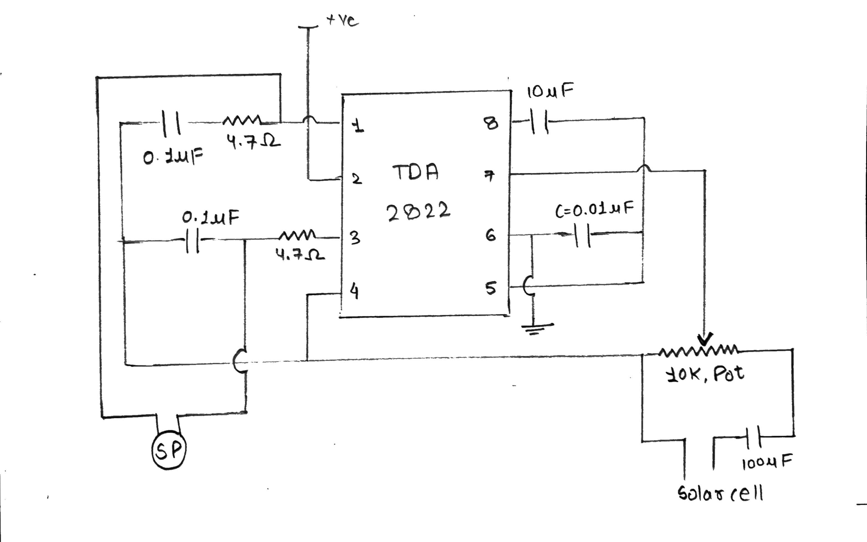
Receiver Circuit Diagram

Slide 7
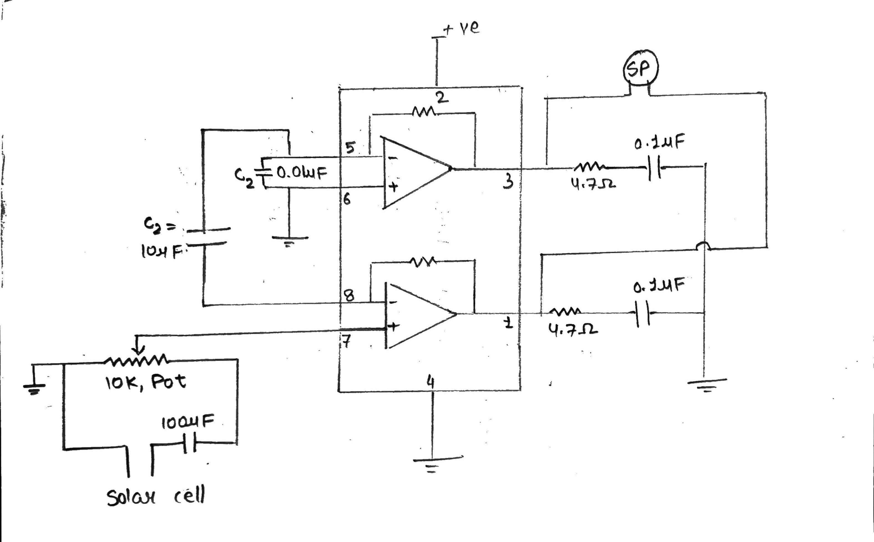
Receiver Circuit (with IC internal schematic)

Slide 8







Amplifier Design in Receiver
Signal Input
Sinusoidal signal from potentiometer fed to bottom non-inverting OPAMP.
Dual Amplification
Bottom OPAMP outputs amplified sine wave; top inverting OPAMP outputs inverted sine wave.
Speaker Drive
3
180° phase difference between terminals creates voltage differential for speaker operation. Causes further amplification.

Slide 9
Advantages of Solar Panels as Photodetectors
Higher Bandwidth
Stronger Signal
Better Signal-to-Noise Ratio
Solar panels respond to kHz-MHz light fluctuations, ideal for Li-Fi's fast LED modulation.
Solar panels generate 0.5-1V under bright LED light.
Solar cells have higher signal-noise ratio (100:1).
LDRs produce only mV-level signals, often buried in noise.
LDRs typically have lower ratios (2:1) and slower response times.
LDRs are limited to 10-100 Hz, missing high-frequency signals.

Slide 10

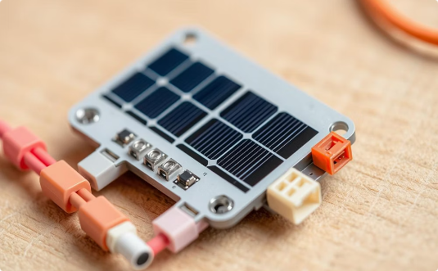
Sensor Elements
Potentiometer
Solar Panel
Senses user-adjusted rotation (mechanical input) to control audio volume by varying resistance.
Senses modulated light intensity from the LED and converts light pulses into electrical signals.

Slide 11


Applications
Underwater Communication
Uses blue-green light (low attenuation in water) for high-speed data transmission, replacing RF signals which attenuate quickly.
.
Connectivity in Remote/Disaster Areas
Solar-powered LED systems enable easy deployment of temporary, energy-efficient networks where infrastructure is lacking.
.
Overcoming RF Spectrum Congestion
Utilizes visible light spectrum (10,000x larger than RF) for higher bandwidth, reducing congestion in urban areas.
.
Energy Efficiency
Integrates with existing lighting infrastructure (e.g., LEO satellites) to reduce energy consumption while providing dual-purpose illumination and data transmission.
.
Secure Military Communication
Provides encrypted, high-speed data transfer using light waves, enhancing security in sensitive operations.
.

Slide 12


Acknowledgements
We sincerely thank Dr. Perumal Alagarsamy for providing us the opportunity to bridge theoretical concepts with practical implementation by developing this Li-Fi communication system. We are also grateful to Perumal Sir and Dolly Gogoi Ma’am for permitting us to utilize the laboratory facilities for circuit fabrication, testing, and for granting access to components such as the potentiometer. Their guidance and support were instrumental in the successful execution of this project.

